Slide 1
Healthcare Data Cleaning and Analysis
"This project aims to clean, organize, and analyze healthcare datasets by addressing issues such as missing values, inconsistencies, and inaccuracies in patient data. The focus is on improving data quality to enable accurate trend analysis and better decision-making in healthcare outcomes."

Slide 2
Objective
To ensure data accuracy and consistency by cleaning and standardizing healthcare datasets.
To handle missing values effectively to enhance the reliability of healthcare analytics.
To extract meaningful insights through the analysis and visualization of trends in healthcare outcomes.

Slide 3
Impactful usages:
Improving Patient Care
Enhancing Operational Efficiency
Facilitating Predictive Analytics
Supporting Healthcare Research
Clean data ensures accurate diagnoses and personalized treatment plans by providing healthcare professionals with reliable patient information.
Data cleaning reduces inefficiencies, streamlining administrative tasks like scheduling, billing, and resource management.
Analyzing clean data helps in predicting healthcare trends (e.g., disease outbreaks, hospital admissions), enabling proactive interventions.
Clean and organized data is crucial for high-quality research, improving the reliability of findings and helping to identify emerging health trends.

Slide 4
Example:
Age
Sex
ChestPainType
RestingBP
Cholesterol
FastingBS
MaxHR
ExerciseAngina
Oldpeak
HeartDisease
63
1
3
145
233
1
150
0
2.3
1
67
1
2
160
286
0
108
1
1.5
1
67
1
2
120
229
0
129
1
2.6
1
64
1
3
150
244
0
135
0
2.4
1
55
0
3
140
192
0
148
0
2.3
1

Slide 5
How To Run The Project
Install Python
Install Libraries
Prepare Dataset
Run script
View Insights

Slide 6
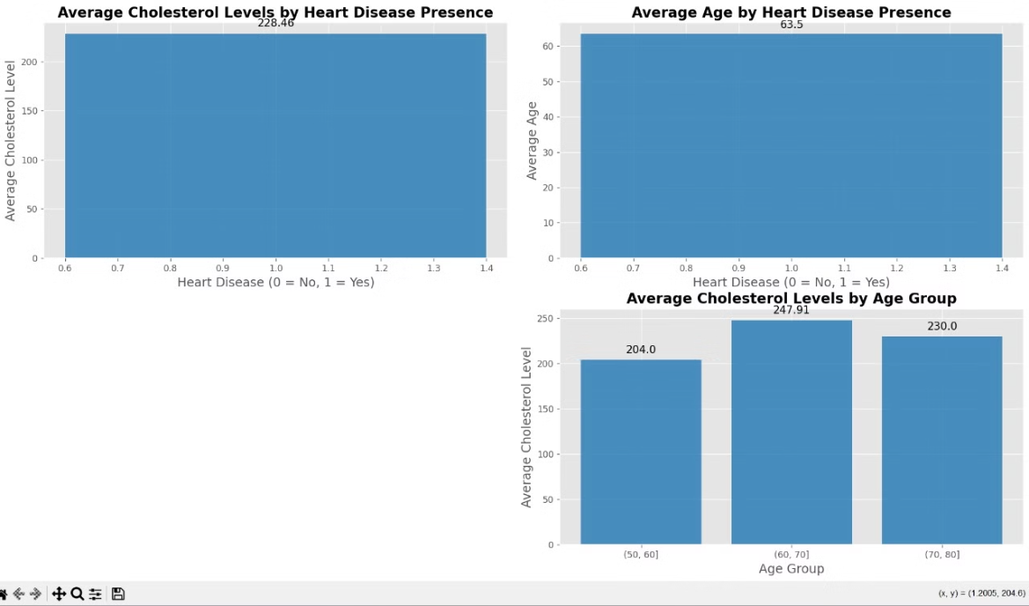
OUTPUT

Slide 7
Obstacles During development
Data Quality Issues
Missing or Inaccurate Data: Some data points might be missing, or incorrect data can cause problems in analysis.
Large Data Volumes
Handling Big Datasets: Large amounts of healthcare data can be tough to store, process, and analyze efficiently.
Bias in Data
Unrepresentative Data: Some patient groups might be underrepresented in the data, affecting the results.
Ethical Issues
Responsible Use of Data: Ensuring the data is used ethically to improve patient care and not for harmful purposes.

Slide 8
Future Steps
Data Collection and Preparation
Gather Data: Collect healthcare data from reliable sources (e.g., hospital records, public datasets).
Data Cleaning: Handle missing values, remove duplicates, and correct inconsistencies.
Data Exploration
Understand the Data: Explore and analyze the data to understand its structure and patterns.
Visualize Trends: Use charts or graphs to visualize key metrics like age distribution, blood pressure levels, etc.
Model Building and Analysis
Statistical Analysis: Apply statistical techniques to uncover insights from the data (e.g., correlations between risk factors and heart disease).
Predictive Modeling: If applicable, build machine learning models to predict outcomes like heart disease risk.
Ethical Considerations
Ensure Data Privacy: Follow privacy laws to protect patient data and ensure confidentiality.
Address Bias: Check for biases in the data and take steps to minimize their impact on the results.

Slide 9
Thank You
Patel Shrey
Patel Parth
Patel Manush
Aman chordia

